Slide 1
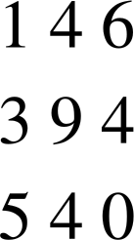
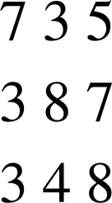
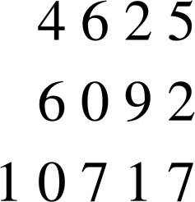
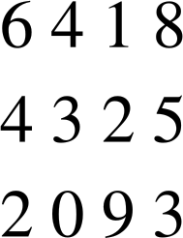


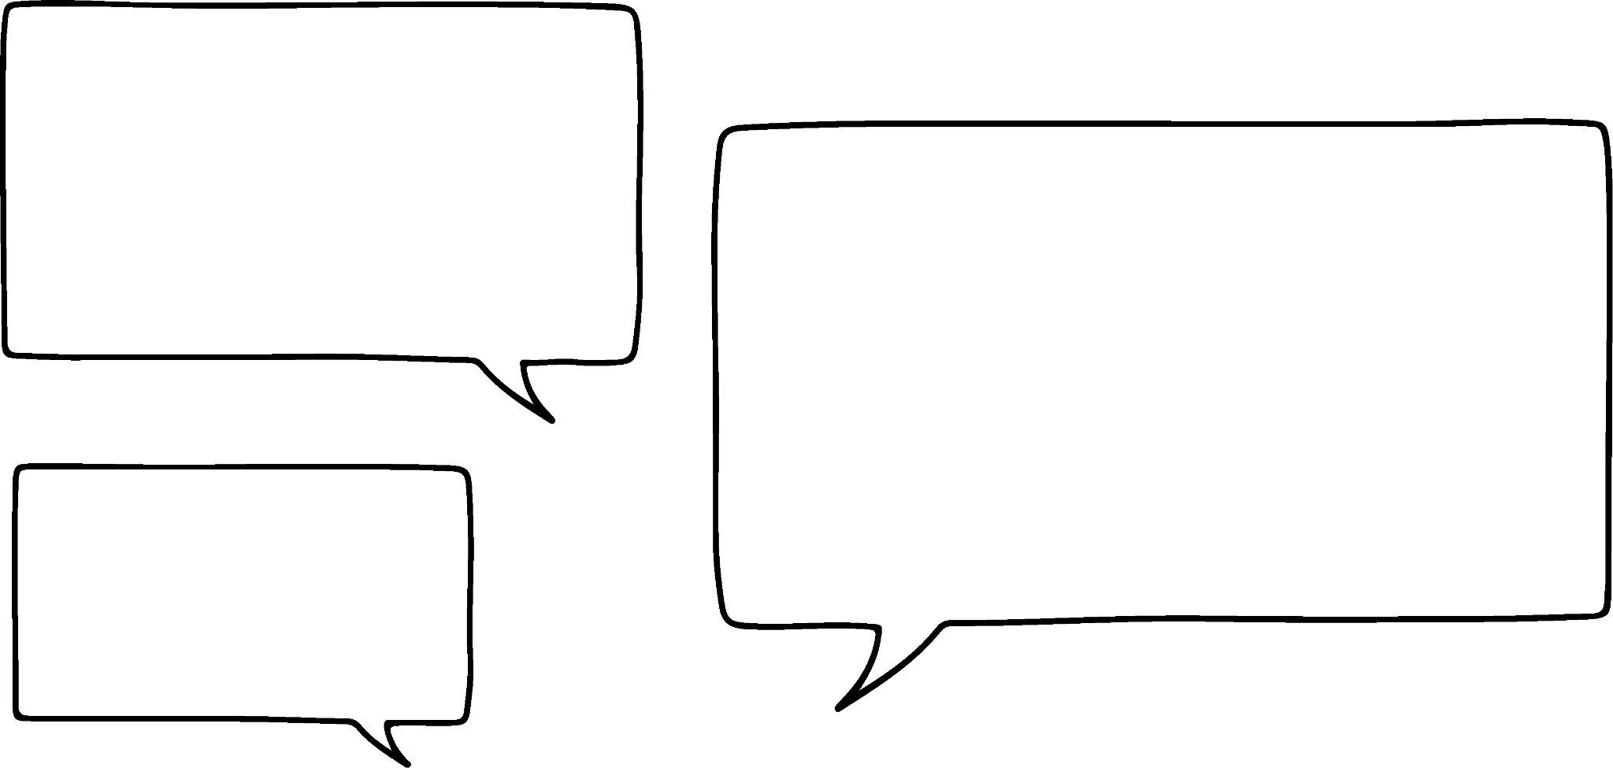





Checking understanding of arithmetic procedures with integers and decimals
Task A: Arithmetic procedures with integers
Find the missing digits in each of the following:
a)
b)
c)
d)
+
−
+
−
2) Calculate the following, without a calculator. Try to use the efficient methods we have talked about.
580 × 5
87 × 4
26 × 8
45 × 6
485 ÷ 5
= 580 × 10 ÷ 2 = 5800 ÷ 2 = 2900
= 87 × 2 × 2 = 174 × 2 = 348
= 26 × 2 × 2 × 2 = 52 × 2 × 2 = 104 × 2 = 208
= 45 × 3 × 2 = 135 × 2 = 270
= 485 ÷ 10 × 2 = 48.5 × 2 = 97
Task B: Addition and subtraction of decimals
Sofia and Andeep record how far they kick a football.
What is the total distance? 22.53 metres
How much further did Sofia kick the ball? 2.93 metres
I kicked it 12.73 metres.
I kicked it 9.8 metres.
2) Lucas, Aisha and Jun record how long they can bounce a basketball for.
What is the total time? 91.92 seconds
How much longer did Lucas manage than Jun? 7.73 seconds
I did 35.6 seconds.
And, I managed
27.87 seconds.
I did 28.45 seconds.

Slide 2
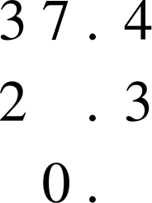
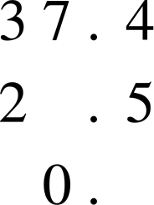
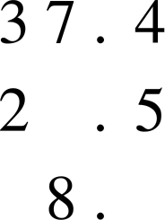

Checking understanding of arithmetic procedures with integers and decimals
3) Here are three slightly different subtractions.
a)
b)
c)
−
7
−
6
−
8
1
1
1
9
0
9
Without calculating, explain why the following statements are false.
The digit in the must be 1 in each calculation as the tenths digits are one apart. True for a but not b & c, as we subtract the bottom digit from the top
The digit in the must be 7 in both cases as the difference is 0. True for a but not b, as the 1 of the ones would have been exchanged for 10 tenths
The digit in the must be 1 in all three calculations as 3 − 2 = 1. True for a & b but not c, as 1 of the tens would have been exchanged for 10 ones
Find the missing digits.
Task C: Multiplication and division of decimals
Match the operation on the left to its equivalent on the right.
× 5
× 2 × 2 × 2
÷ 4
÷ 2 ÷ 2
× 8
÷ 2 ÷ 3
÷ 5
× 10 ÷ 2
÷ 6
× 2 × 3
× 6
÷ 10 × 2
£4.75
2) Find the cost of the following:
2 boxes £9.50
10 boxes £47.50
5 boxes £23.75
6 boxes £28.50
3) The Oak students decide to buy one box of chocolates between them.
Work out how much each person pays if:
2 students buy the box £2.90
4 students buy the box £1.45
5 students buy the box £1.16
£5.80
Mathematics in Education and Industry

